Slide 1
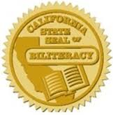
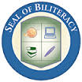
“Pathways to Biliteracy” Awards
Mrs. Claudia Sachs

Slide 2
A State Seal of Biliteracy
AB 815 was signed by the governor and enacted into California Education Code on October 8, 2011.
The Seal of Biliteracy Award certifies high school seniors’ attainment of mastery of two or more languages and is honored in many of California’s districts in Orange County.
This award encourages students to attain biliteracy, honors the achievement of our students, and encourages students’ college and career readiness and preparation with 21st century skills.

Slide 3
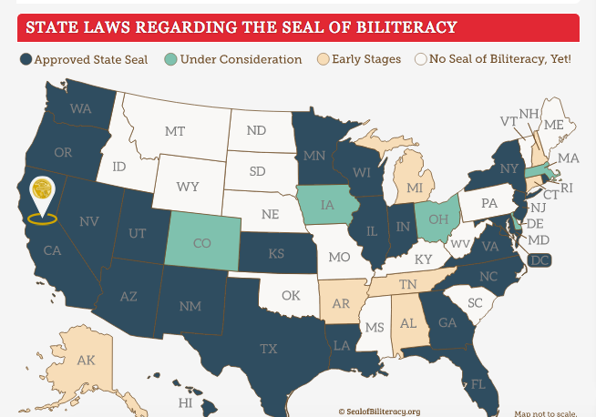
A State Seal of Biliteracy
Twenty-three states now offer a “Seal of Biliteracy," and at least 10 more are working toward implementing a similar award.

Slide 4
Biliteracy Pathway Awards
Biliteracy Pathway Awards recognize the significant steps towards developing biliteracy along a student’s trajectory from preschool into high school. The purposes for instituting the Seal of Biliteracy and the Pathways to Biliteracy Awards are numerous. Here at OCEAA we recognize students for the following purposes:
To recognize and value bilingualism
To recognize and value biliteracy
To recognize and value the multi-cultural competencies our students posses
To honor the multiple cultures and languages in our community
To foster high levels of self-esteem and pride in language and culture
To encourage students to study languages
To certify the development of biliteracy skills
To prepare students with 21st century skills that will benefit them in the labor market and the global society

Slide 5
OCEAA Recognition Levels Pathway Awards
G3- Biliteracy Award
G3- Bilingual Award
G6- /Biliteracy Award (TWBI)
G6- Bilingual Award (EM)
G8- Biliteracy Award (TWBI)
G8- Bilingual Award (EM)

Slide 6
Criteria and Assessment -3rd Grade
“Pathways to Biliteracy” Award-This award is designed to measure attainment of age-appropriate biliteracy for students who have been in the Two-Way Bilingual Immersion Program. The criteria is:
Overall 4 or 5 on CELDT, with no skill area below 3 for English Learners
Spanish Language Arts score at “Proficient” or higher on grade level assessment
English Language Arts score at “Approaching” or higher on grade level assessment(s)
Oral & Listening proficiency in the target language
Completion of a Reading Log- 10 books in English AND 10 books in Spanish
Documentation of active use of the Spanish language – must register 5 events
Oral presentation on 3rd grade content in both languages
Friendly letter written in both languages

Slide 7
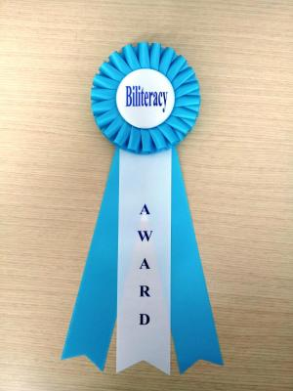
Criteria and Assessment -3rd Grade
Bilingual Award-This award is designed to reward engagement in pursuit of language skills in two or more languages, to affirm positive attitudes towards multilingualism, and to validate the use of multiple languages for all students. The Criteria includes meeting two requirements from items 1-4 (below) and all of the last four bulleted requirements:
Overall 2-5 on CELDT for English Learners
Spanish Language Arts score at “Proficient” or higher on grade level assessment
English Language Arts score at “Approaching” or higher on grade level assessment
Oral & Listening proficiency in the target language
Completion of a Reading Log- 5 books in Spanish and 5 books in English
Documentation of active use of the Spanish language – must register 5 events
Oral presentation on 3rd grade content in both languages
Friendly letter written in one language

Slide 8
Criteria and Assessment -^{6th} Grade
“Pathways to Biliteracy” Award-This award is designed to measure attainment of age-appropriate biliteracy for students who have been in Two-Way Bilingual Immersion Program. The criteria is:
Overall 4 or 5 on CELDT, with no skill area below 3 for English Learners
Spanish Language Arts score at “Proficient” or higher on grade level assessment
English Language Arts score at “Proficient” or higher on grade level assessment
Oral & Listening proficiency in the target language
Completion of a Reading Log- 10 books for in English and 10 books in Spanish
Documentation of active use of the Spanish language – must register 5 hours
Oral presentation on 6th grade content in both languages
Response to literature essay written in both languages

Slide 9
Criteria and Assessment -^{6th} Grade
Bilingual Award- The intent of this award is to encourage any student, including students in the English Mainstream Program, along the path of bilingualism, and to place value on the use of two languages. The Criteria includes meeting two requirements from items 1-4 (below) and all of the last four bulleted requirements:
1. Overall 4 or 5 on CELDT, with no skill area below 3 for English Learners
2. Spanish Language Arts score at “Proficient” or higher on grade level
assessment
3. English Language Arts score at “Proficient” or higher on grade level
assessment
4. Oral & Listening proficiency in the target language
Completion of a Reading Log- 10 books in English OR 10 books in Spanish
Documentation of active use of the Spanish language – must register 5 hours
Oral presentation on 6th grade content in one language
Response to literature essay written in one language

Slide 10
Criteria and Assessment -^{8th} Grade
“Pathways to Biliteracy Award”-This award is designed to measure attainment of age-appropriate biliteracy for students who have been in Two-Way Bilingual Immersion Program. The criteria is:
Overall 4 or 5 on CELDT, with no skill area below 3 for English Learners
Spanish Language Arts score at “Proficient” or higher on grade level assessment
English Language Arts score at “Proficient” or higher on grade level assessment
Oral & Listening proficiency in the target language
Completion of a Reading Log- 10 books in English and 10 books in Spanish
Documentation of active use of the Spanish language – must register 5 hours
8th grade presentation on 8th grade content in both languages
Argumentative essay written in both languages

Slide 11
Criteria and Assessment -^{8th} Grade
Bilingual Award- The intent of this award is to encourage any student, including students in the English Mainstream Program, along the path of bilingualism, and to place value on the use of two languages. The Criteria includes meeting two requirements from items 1-4 (below) and all of the last four bulleted requirements:
Overall 4 or 5 on CELDT, with no skill area below 3 for English Learners
Spanish Language Arts score at “Proficient” or higher on grade level assessment
English Language Arts score at “Proficient” or higher on grade level assessment
Oral & Listening proficiency in the target language
Completion of a Reading Log- 10 books in English OR 10 books in Spanish
Documentation of active use of the Spanish language – must register 5 hours
8th grade presentation on 8th grade content in one language
Argumentative essay written in one language

Slide 12
Timeline of Events
December-
Parent and student presentations
January-
Possibly another parent workshop
February-
Workshop for students #1 – Date TBD
April-
Workshop for students #2 – Date TBD
May
All requirements due on the last week in May
June-
Biliteracy & Bilingual Awards recipients are announced and awarded on the last week of school

Slide 13
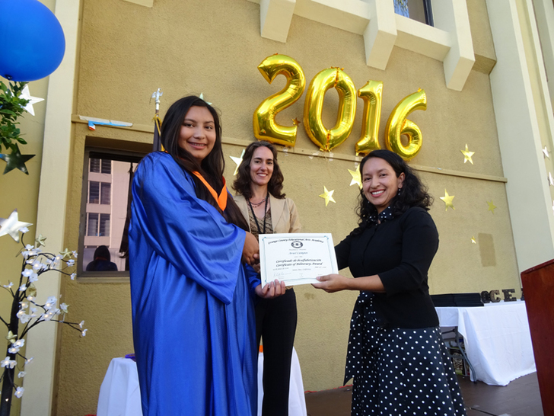
Video
https://youtu.be/RZQrUnYk_BU
https://www.youtube.com/watch?v=RZQrUnYk_BU&feature=youtu.be

Slide 14
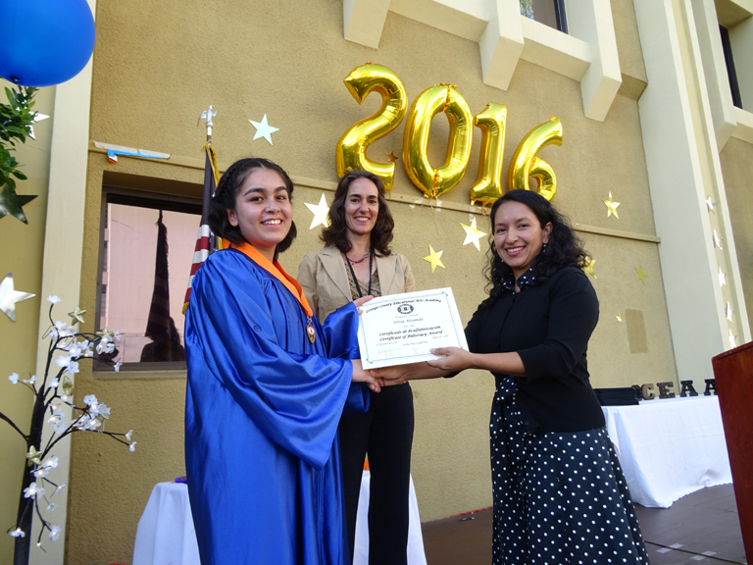

Slide 15
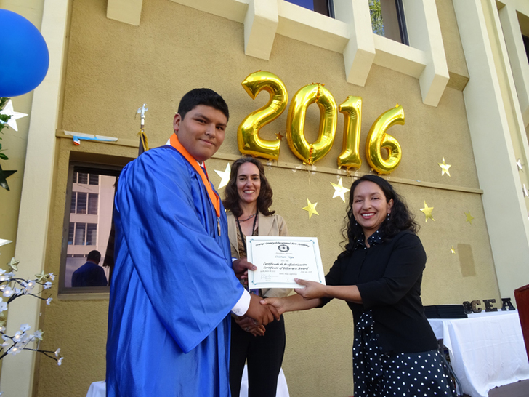

Slide 16
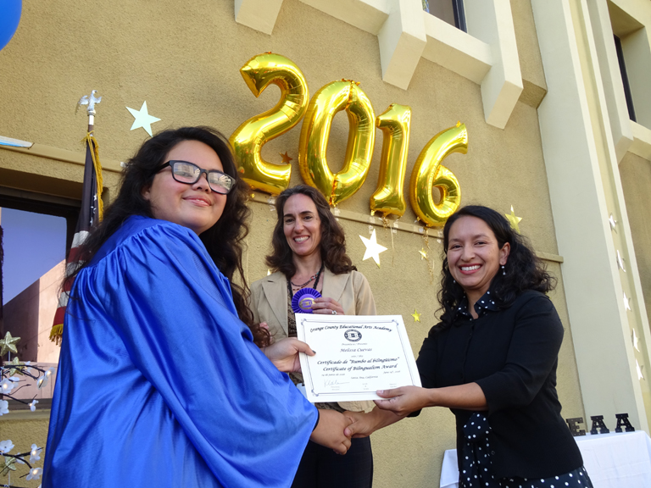

Slide 17
High School
Ask at your child’s high school if the district has a Board approved policy for the “Seal of Biliteracy”
If not, join their ELAC or attend SSC and advocate for it!

Slide 18
¡Gracias por su tiempo! Thank you for your time!
¡Quien sabe dos lenguas
vale por dos!
S/He who speaks two languages is worth twice as much!

